Slide 1
Exploring the Needs of Educators Working with Pre-School Bilingual Language Learners: The Case of Russian Language Online School Live Fairytales
CALICO Conference 2018
Connecting CALL’s Past to its Future
May 29 – June 2
Gulnara Sadykova
Albina Kayumova
Liliia Khalitova
Gulnara Gimaletdinova

Slide 2
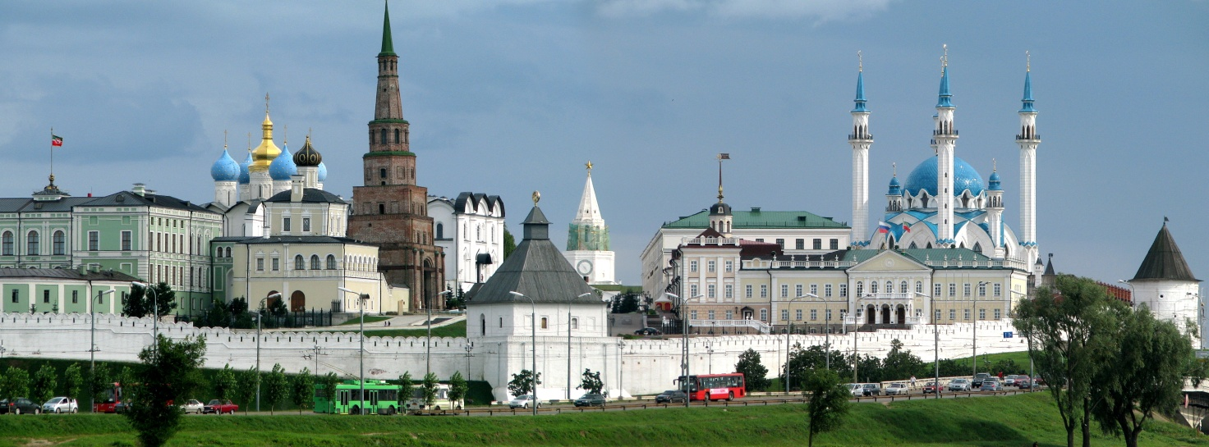
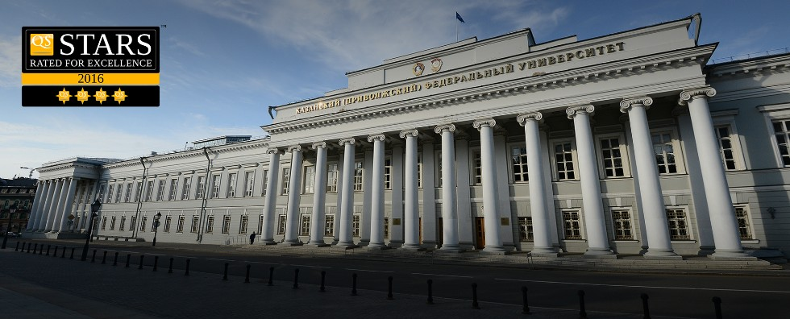
Kazan Federal University
Kazan: the capital and the largest city (1 mln 200 people) of the Republic of Tatarstan, European Russia; a city where Russian (48,6%) and Tatar (47,6%) cultures meet
Kazan Federal University, one of the oldest universities in Russia (founded in 1804)
Leo Tolstoy Institute of Philology and Intercultural Communication at Kazan Federal University
2

Slide 3
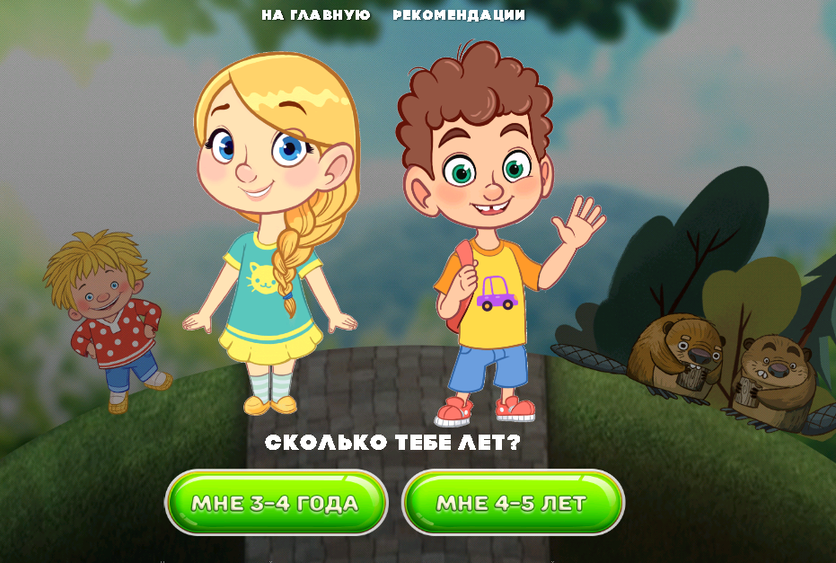
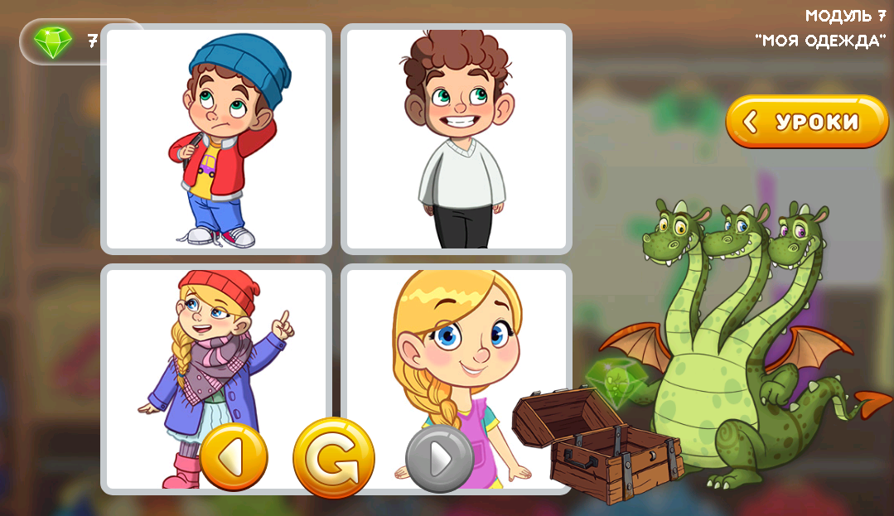
Project Focus
Online Russian language activities for young learners Zhivyje Skazky (Live Fairytales)
Target learners: bilingual children aged 3-5 living in multilingual areas of Russia and Russian diaspora abroad
A non-commercial project supported by the federal program Russian Language 2016-2020
Designed in Kazan Federal University, Republic of Tatarstan, Russia
Project aimed at designing and testing the content and language learning materials
Includes 2 levels, 8 modules with 8 original fairytales for each level, with audiovisuals and interactive activities
Strong focus on culture, development of core vocabulary and grammar patterns
Elements of gamification aimed at increasing participation, engagement and competition
3

Slide 4
Designing Live Fairytales
Language map
Psychological map
Cultural map

Slide 5
Live Fairytales Project Team
Content experts:
academic linguists, including a writer
early-childhood education expert
IT specialists:
programmers
developers of audio-visual content
artists

Slide 6
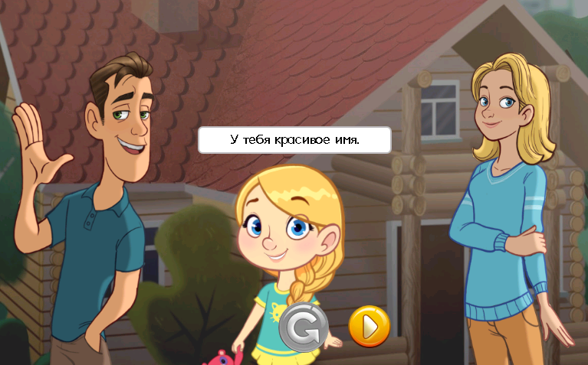
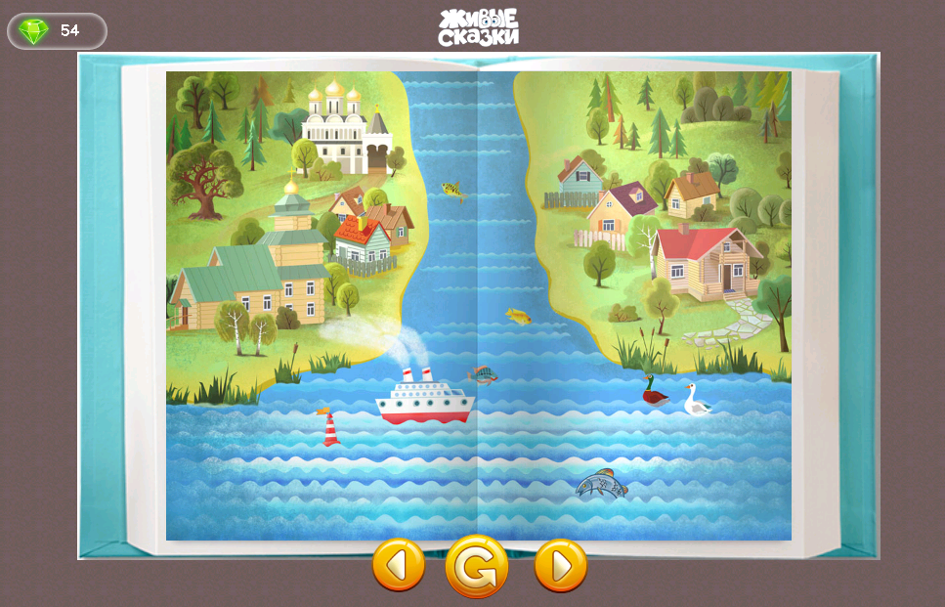
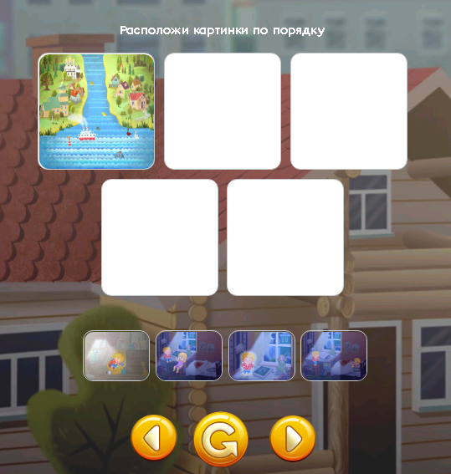
Structure of each Live Fairytales Module
Introductory activities
introduce the topic
A fairytale
audio recording of a shortened and a longer version of a fairytale
Interactive post-text activities
focus on listening comprehension
activate target vocabulary
colorful illustrations
acquisition and practicing target vocabulary and speech patterns
interactive activities
make a focus on cultural elements

Slide 7
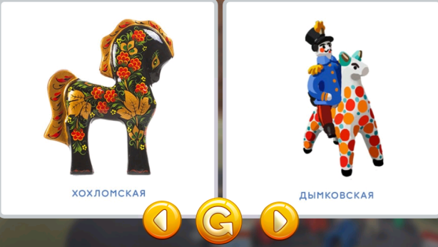
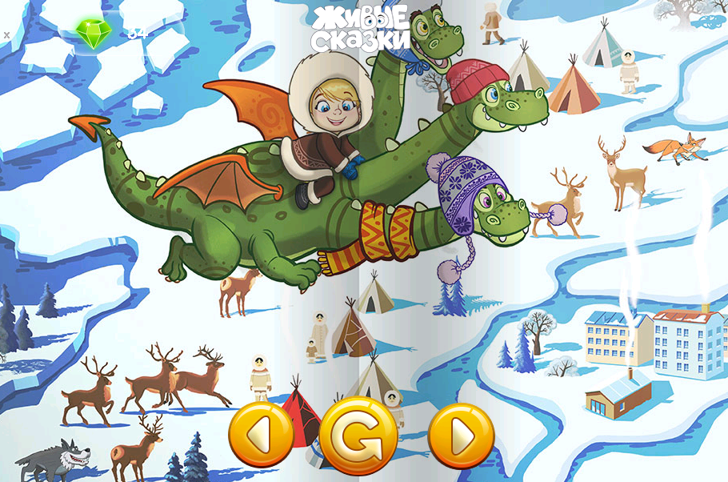
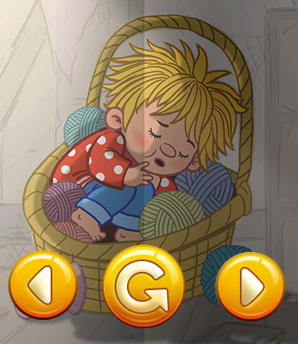
Cultural Diversity
Integrating the personages of traditional Russian folk fairytales (Domovoy, Zmey Gorynych)
Focus on local realia of different regions within Russia
Practicing culturally specific vocabulary
7

Slide 8
Purpose and Perspectives
Significance of maintaining language and culture in multienthic regions and in the situation of high migration rates (150 languages in 83 regions of Russia)
Commercial CALL software products and significance of culture within CALL (Shaughnessy, 2003)
Supporting technology-mediated language education for young learners (Cummins, 2008; Lohe & Elsner, 2014)
Matching new literacies of young learners (Meskill, Mossop & Bates, 1999)
Focus on interactions in a given socio-historical context: Vygotskian perspective (Vygotsky, 1991)
8

Slide 9
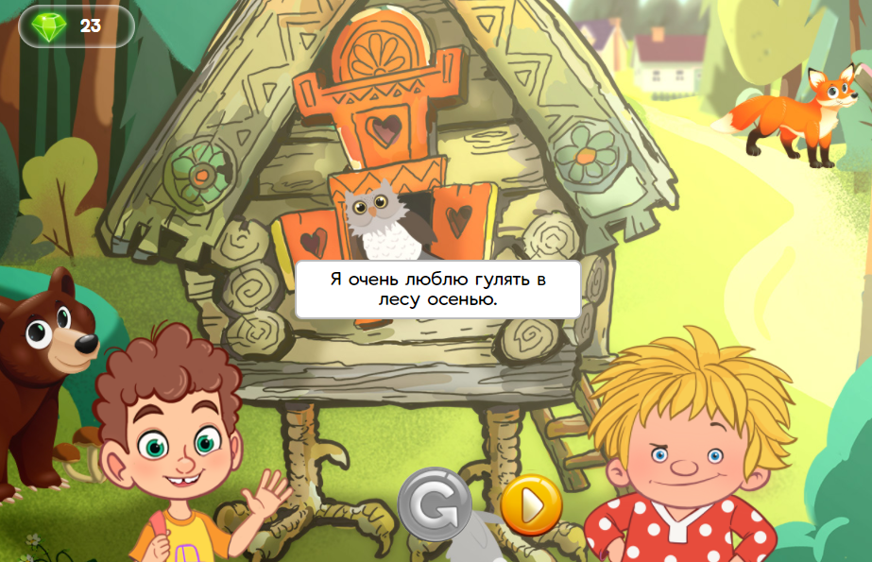
Mode of Inquiry & Data Sources
Research Questions:
How the newly developed online school material meets the needs of educators who work with very young learners?
What multimodal design features and content elements of online project Live Fairytales are to be changed and improved before integration of other modules?
Testing a demo-version of Module 1, monitoring students and educators at kindergartens, collecting educators’ feedback
Data sources: reports filled out by educators, classroom interactions in 5 focal sites, questionnaire and interviews with 6 school developers
9

Slide 10
Stage 1: Pre-Testing activities
December 2016 - January 2017
Meeting with educators
Preparing a feedback report template
Giving recommendations on conducting Module 1 testing
Handing out feedback report templates to educators for subsequent filling
10

Slide 11
Stage 2: Testing Module 1 of the Project
Stage 3: Post-Testing Activities
February - March 2017
Testing Module 1 at kindergartens with both age groups (3-4 and 4-5-year olds)
Monitoring students and educators
Collecting educators’ feedback reports
April - May 2017
Analyzing the data
Making improvements to other Modules of Live Fairytales
Integrating the project into other kindergartens

Slide 12
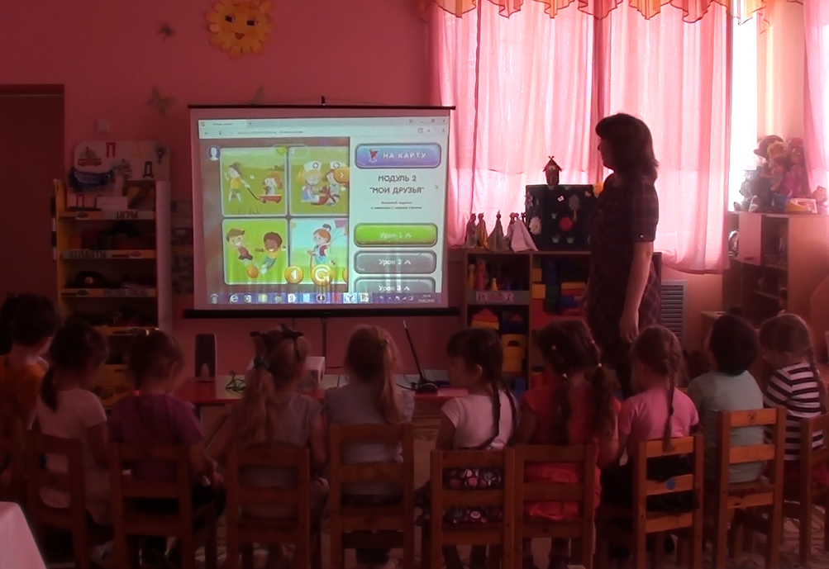
Sites & Educators: Site #1
State-funded kindergarten/preschool located in the town of Laishevo, opened in 2007. 197 children, 44 staff members including 17 educators
Observation Group: 14 children aged 3-5. Main language of interaction – Russian
Educator: female, Tatar, 30-year old, 6 years teaching experience
12

Slide 13
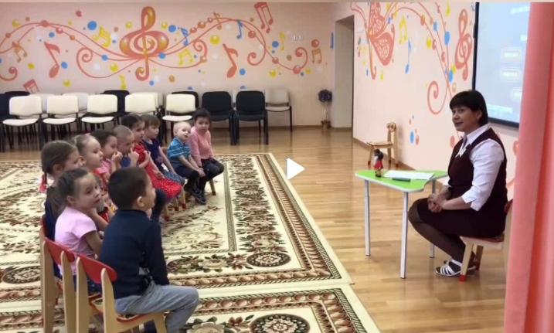
Sites & Educators: Site #2
State-funded kindergarten located in the town of Bogatye Saby, opened in 2014. 144 children and 15 educators
Observation Group: 14 children aged 4-5. Main language of interaction – Tatar
Educator: female, Tatar, 28-year teaching experience (3 years as an instructor of Russian)
13

Slide 14
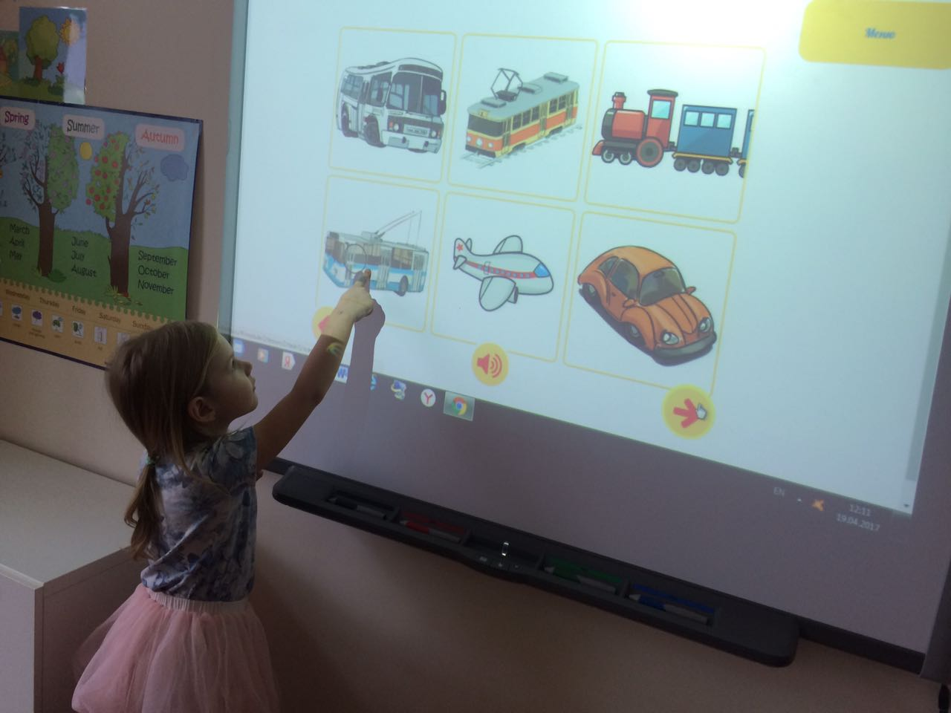
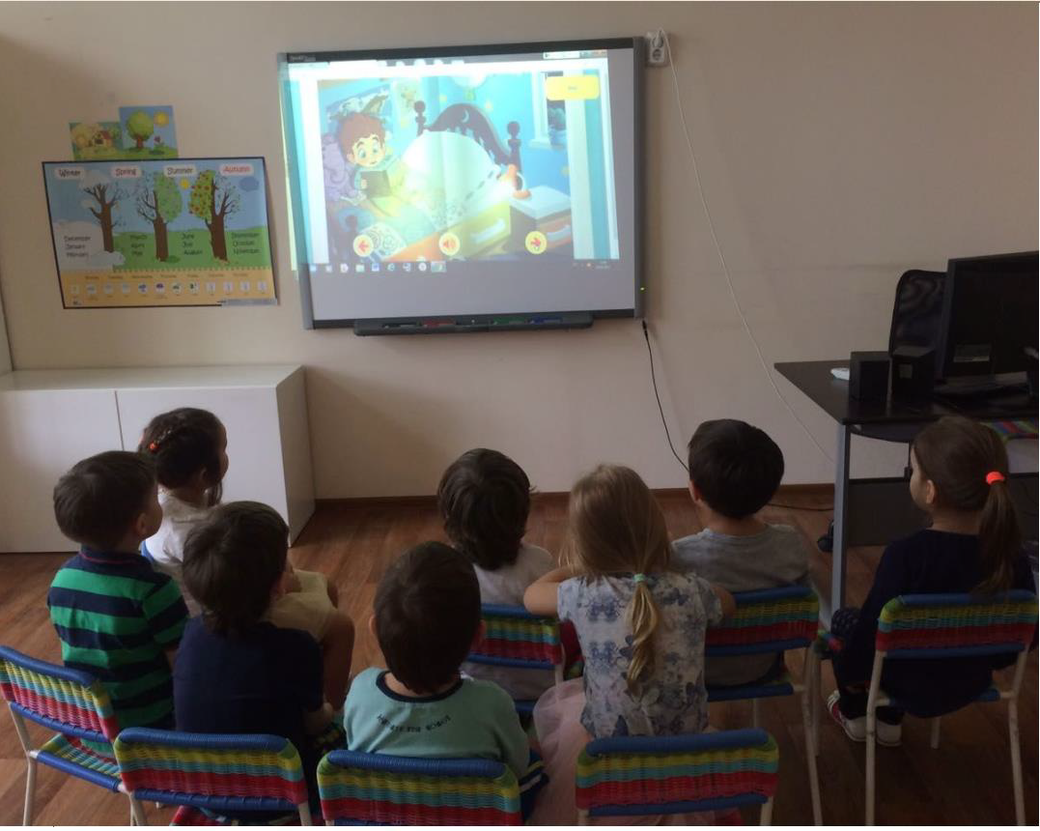
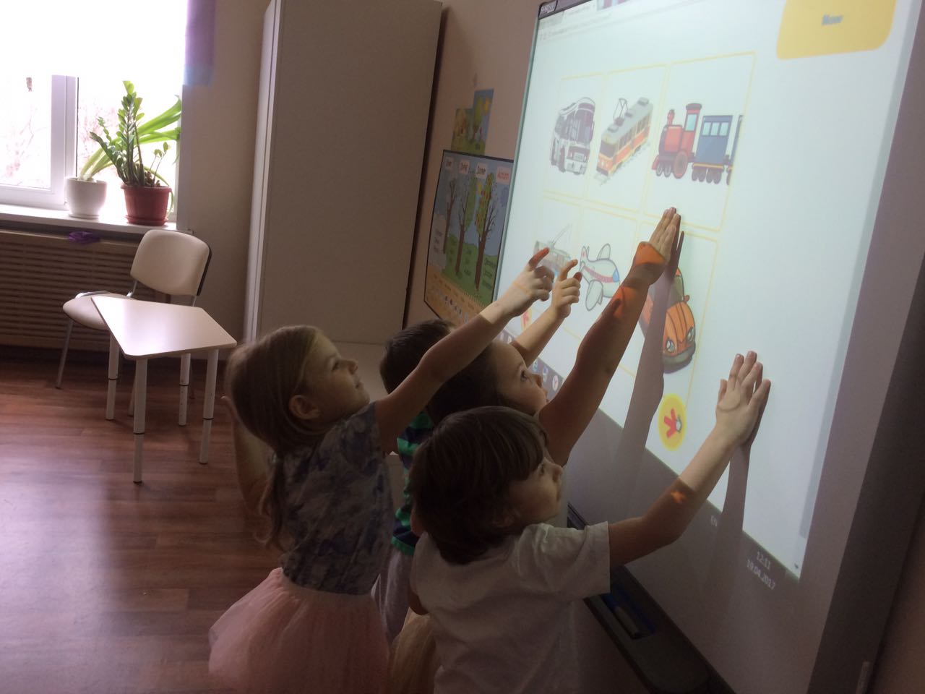
Sites & Educators: Sites #3-5
A private chain of kindergartens
“Bala-City” in Kazan, opened
in 2013
Observation Groups:
8 children aged 4-5
8 children aged 3-4
7 children aged 3-4
23 children aged 3-5 in total
Educators: female, 1 Tatar,
2 Russians
Main language of interaction -
Russian
14

Slide 15
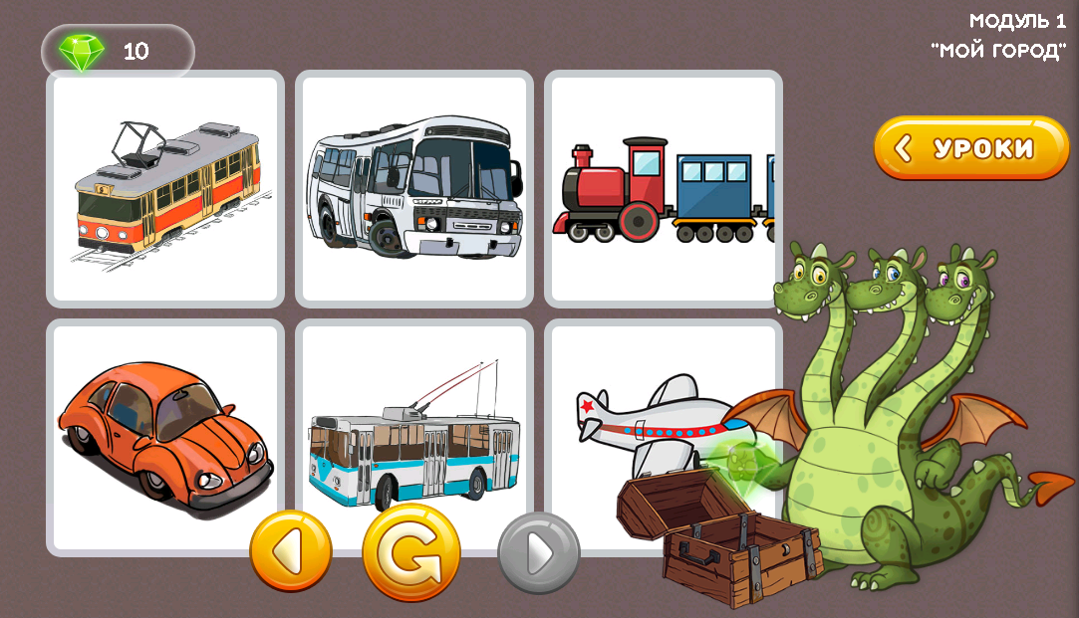
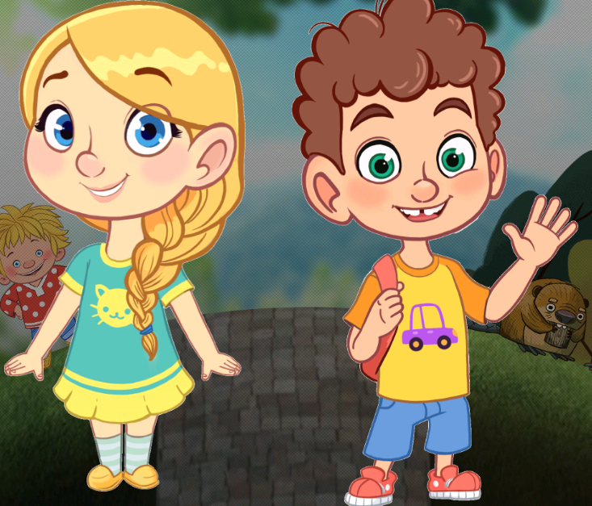
Educators’ Reflections of Demonstration Modules
gamification elements
the length of a short fairytale version
the level of difficulty
digital mediators for language practice
age of learning buddies
choice of appealing and motivating activities
15

Slide 16
Educators’ Reflections of Demonstration Modules: Challenges
dissatisfaction with the length of the full version of the tales
absence of ‘pause’ button/ function
ambiguity and complexity of certain post-listening comprehension tasks
illustrations need to be improved
16

Slide 17
Educators’ Recommendations
1) Adjusting the text content of the modules (mainly, reducing the length of the full version of the tale)
2) Improving the audio-visual content of the modules:
adding songs with key vocabulary and grammar patterns;
adding more illustrations to fairytales;
increasing the size of the illustrations;
adding a "pause" button for listening activities
3) Adjusting the navigation system of the website of the online school (e.g. improving the hyperlink structure, enabling users to skip pages when reading a fairy tale)
17

Slide 18
Making Improvements to Live Fairytales
the text of fairytales was simplified in all modules
the short and the full versions of the fairytales were redesigned
‘pause’ button was added in listening activity
the option of choosing between a female and male voice for audio was added
illustrations were changed to more colorful, background of illustrations was improved
the size of the illustrations was partially increased
dialogues to practice core vocabulary and grammar patterns were added
pre-text and post-text exercisers were improved with a stronger focus on vocabulary practice, including contextual use of focal vocabulary and grammar patterns
18

Slide 19
Conclusions
satisfaction with the school concept
young learners’ excitement over interacting with the project
recommended changes (briefly)
simplification of the language of fairytales
shortening the length of fairytales
adding songs and illustrations
improving navigation system of the website
the necessity of training seminars and workshops for educators
the key role of an educator who is "more capable other" (Vygotsky) assistsing the child in learning
availability of a smartboard in a kindergarten and working in groups are best possible conditions for the use of Live Fairytales
19

Slide 20
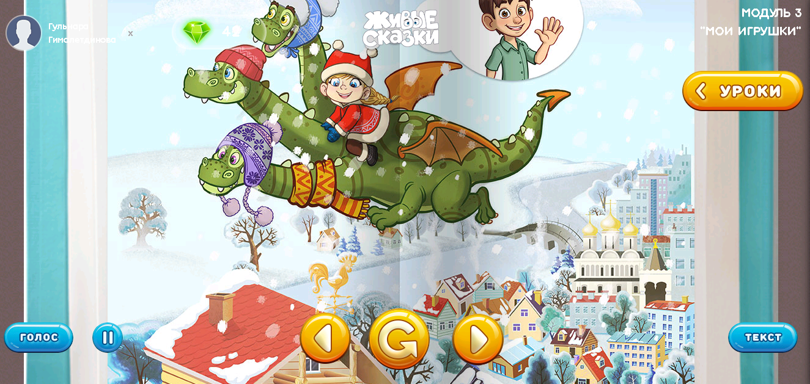
Next Steps
Employ empirical research protocol to assess language acquisition-oriented instructional conversations with and around multimodal material – the triadic scaffold protocol by Meskill (2005)
Development of Live Fairytales for 5-7 year-olds
Publicity of the project via
government agencies and
the internet
Teacher preparation

Slide 21
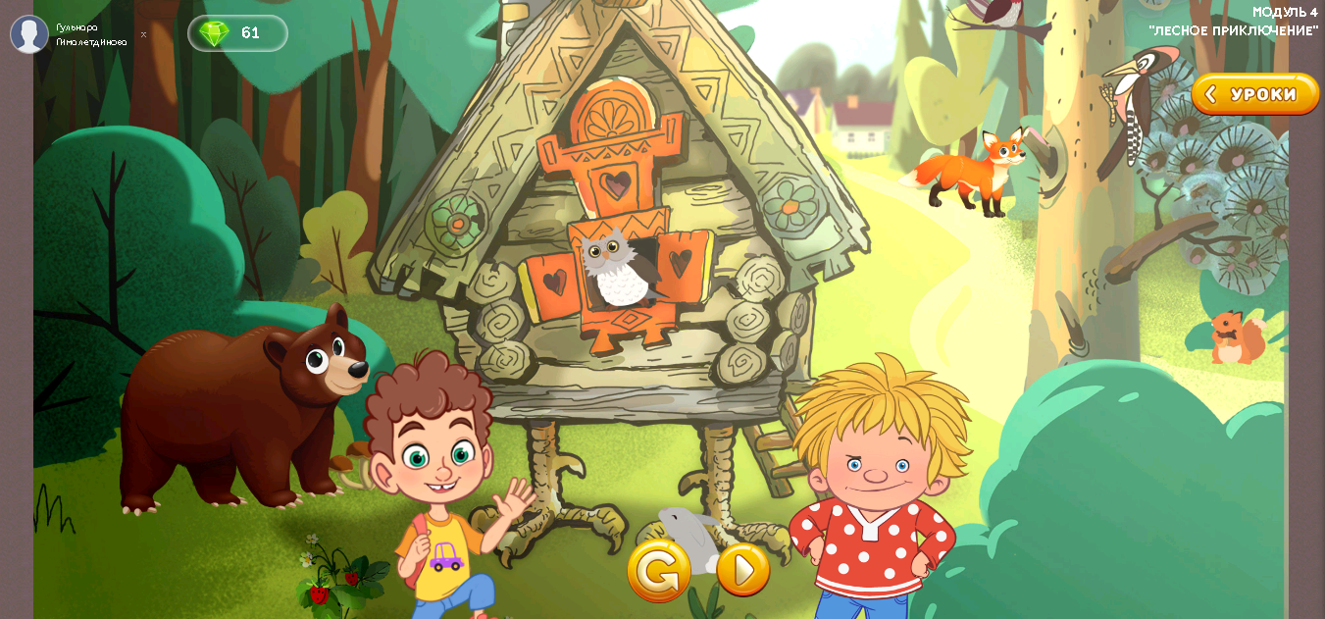
Thank you!
Welcome to Live Fairytales:
http://skazki.pushkininstitute.ru/
Gulnara Sadykova gsadykov@kpfu.ru
Albina Kayumova alb1980@yandex.ru
Liliia Khalitova lilia_khalitova@mail.ru
Gulnara Gimaletdinova gim-nar@yandex.ru

