Slide 1
Demo of Vocab Victor Word Learning Games
By Heidi Brumbaugh, PhD
2018 Calico Conference University of Illinois, Urbana-Champaign
May 31, 2018 Vocabulary Systems, Inc.

Slide 2
Demo of Vocab Victor Word Learning Games
By Heidi Brumbaugh, PhD
2018 Calico Conference University of Illinois, Urbana-Champaign
May 31, 2018 Vocabulary Systems, Inc.

Slide 3
What is Vocab Victor?
What words does Vocab Victor teach?
How does Vocab Victor teach words?
Demo of games/Progress Room
Questions

Slide 4
What is Vocab Victor?

Slide 5
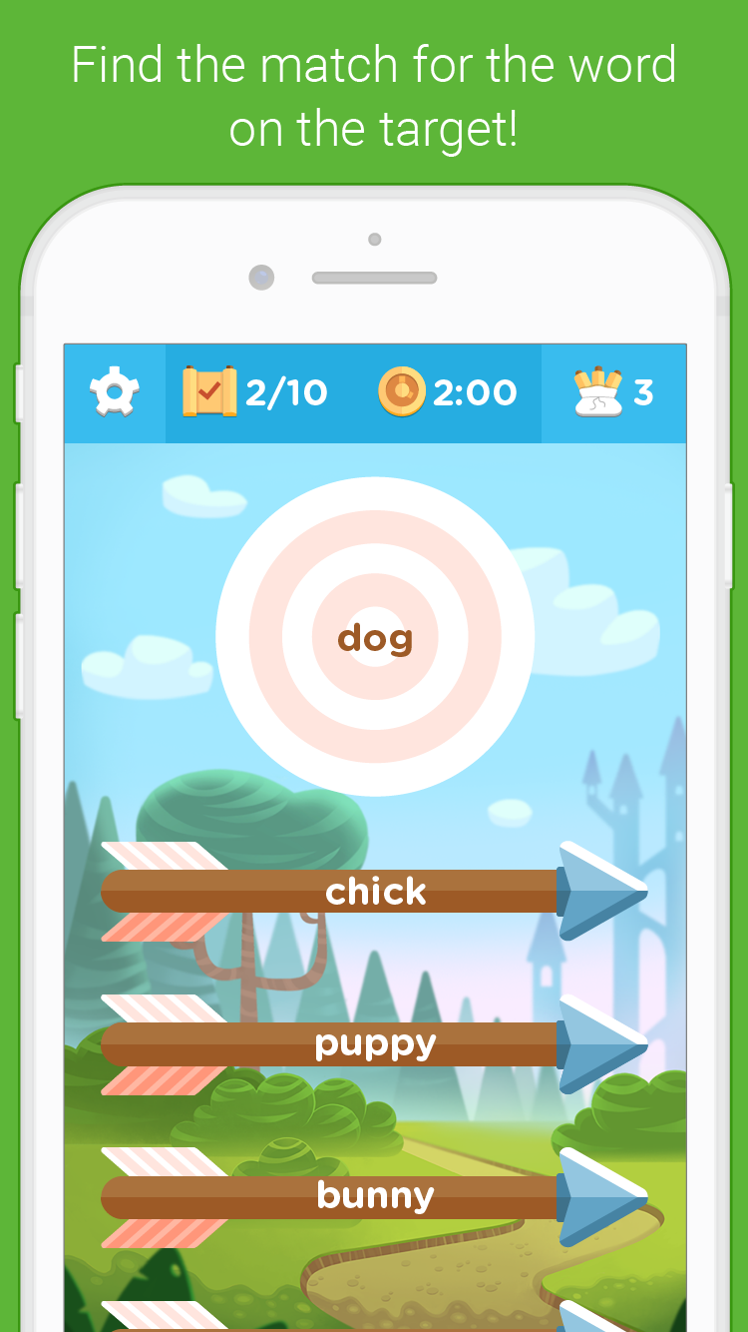
What is Vocab Victor?

Slide 6
What words does Vocab Victor teach?

Slide 7
What words does Vocab Victor teach?
Intermediate level vocabulary

Slide 8
What words does Vocab Victor teach?
Intermediate level vocabulary
Why?

Slide 9
What words does Vocab Victor teach?
Intermediate level vocabulary
Why?
Attempt to make intermediate gains look more like beginning gains

Slide 10
Language learner’s experience
Beginning words
Picked up more quickly

Slide 11
Language learner’s experience
Beginning words
Picked up more quickly
Again, why?

Slide 12
Language learner’s experience
Beginning words
Picked up more quickly
Again, why?
Intersection of cognition and language distribution.

Slide 13
Language learner’s experience
Beginning words
More frequent
Easy to remember

Slide 14
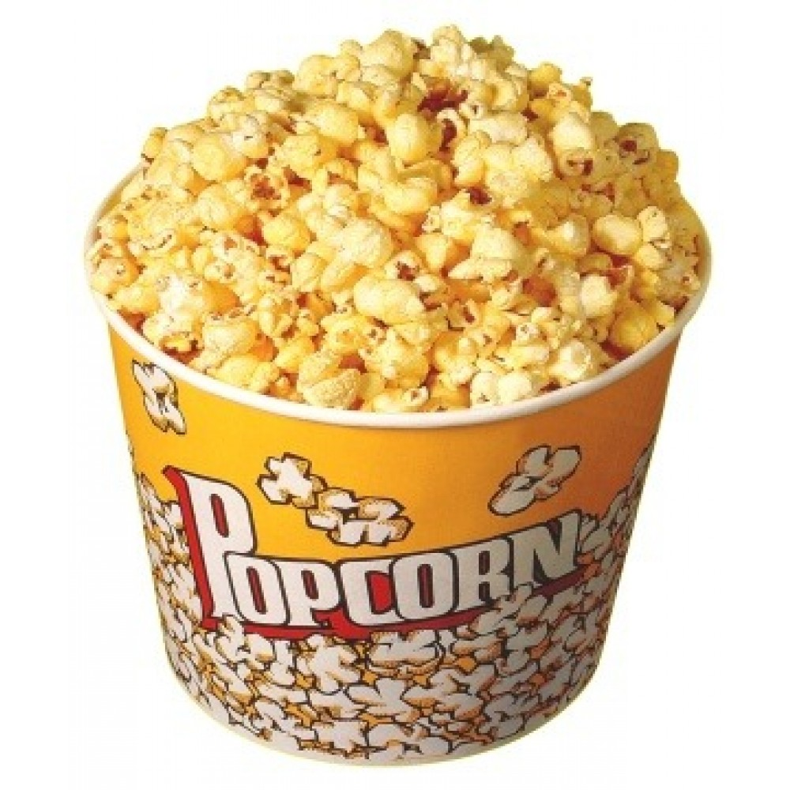
Language learner’s experience
Beginning words
More frequent
Easy to remember

Slide 15
Language learner’s experience
Intermediate words
Less frequent
Harder to remember

Slide 16
What words does Vocab Victor teach?
Strengthen knowledge of frequent words
Teach intermediate words using repetition
More like popcorn,
Less like cocktail party guy

Slide 17
How does Vocab Victor teach words?

Slide 18
How does Vocab Victor teach words?
Well, how are words stored in the mind?

Slide 19
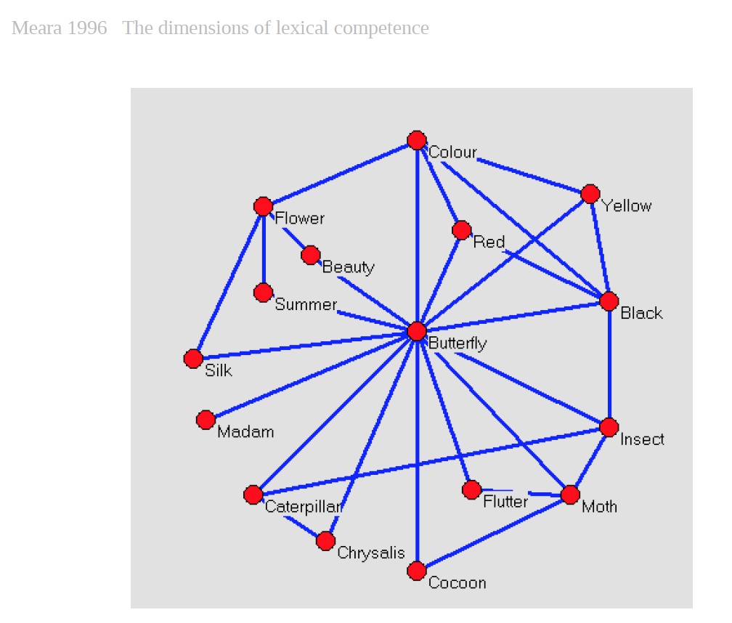
The Mental Lexicon

Slide 20
What do we know about mental lexical networks?

Slide 21
What do we know about mental lexical networks?
Native speakers have very rich associative networks
NNS have very sparse networks
-- Paul Meara

Slide 22
How does Vocab Victor teach words?
by helping learners acquire a native-like mental network of word associations.

Slide 23
(Rest of talk was a live demo.)
Download Vocab Victor to play.
Heidi@VocabSystems.com
References
Meara, P. (1996). The dimensions of lexical competence. Performance and competence in second language acquisition, 35.

