Slide 1
My Ultimate is Almost Ready!: Social and Linguistic Interaction of EAL Learners in Overwatch
Samantha Kirby Lecturer and Gamer University of Arizona e: samkm@email.arizona.edu w: samantha.games
Michelle Vonie PhD Candidate University of Arizona e: vonie@email.arizona.edu

Slide 2
What Is Overwatch?
Multiplayer “hero shooter”
Division of classes between tank, support, and DPS
Contains multiple game modes, such as control point, payload, mystery heroes, etc.
Constantly updated and changing modes and characters
Requires team play for all modes
Notes:
Team Cohesion Objective Explicit Consider: coding when references are to team vs. a specific player

Slide 3
Why Did We Choose It?
Until now, research has focused nearly entirely on RPGs or games with scripted text
A game that focuses on player-to-player language rather than game-to-player language
Each match is divided into rounds
These time-pressured instances require communication (whether it be one-way or two-way) for success
Varied modes between high-stakes and low-stakes
High-stakes modes offer significant consequences (even out of game)
Distinct classes and characters (not just roles)

Slide 4
Research Questions
What are the features patterns of EAL learner social and linguistic interaction in a “hero shooter”?
How do the game mechanics and dynamics of “hero shooters” create affordances for language learners?
How do the language learning affordances compare between lower stakes versus higher stakes game modes?

Slide 5
Methodology

Slide 6
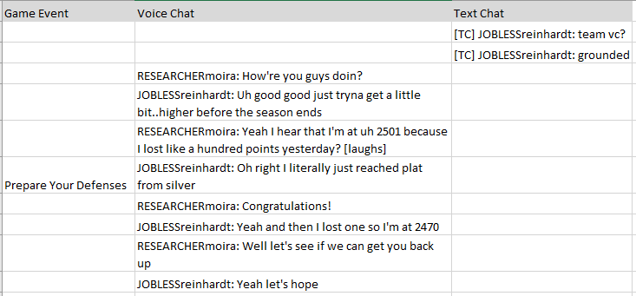
Findings: Teamwork makes the dream work...
Notes:
As we mentioned in the beginning, Overwatch has interesting game phases that lead to important communication.
- note: even though this is with our researcher, this is something we see often, especially in higher level cp (not so much in low level cp or qp)
- because we only see it in higher level cp, it's indicative that it's necessary for success
- we saw over and over a divide between players trying to make others feel good or bad depending on gameplay, but universally the beginnings start like this

Slide 7
Findings: …but how do we get there?
Notes:
- something we want to look into eventually is class role and leadership role

Slide 8
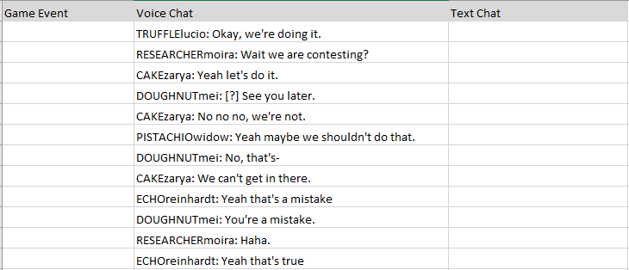
Findings: Strategizing In Game Moment

Slide 9
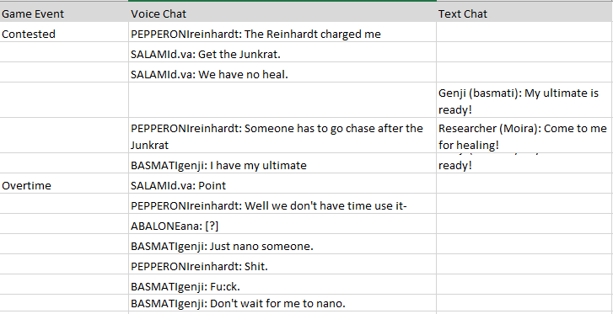
Findings: Explicit Requests

Slide 10
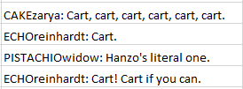
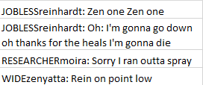
Findings: Implicit Requests

Slide 11
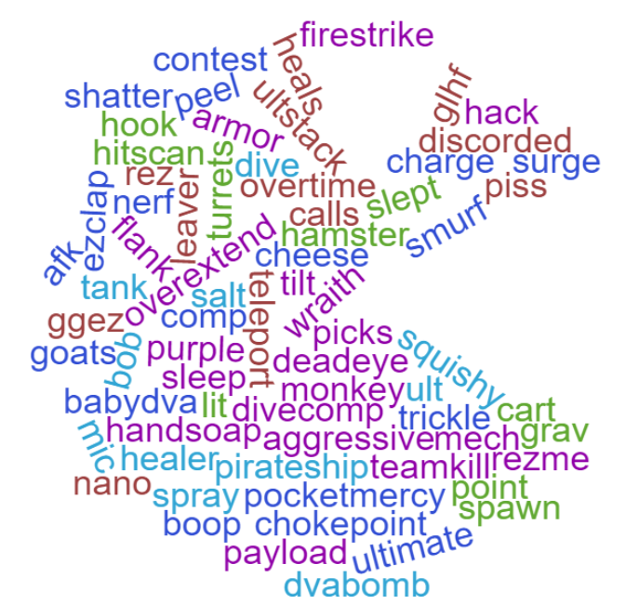
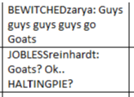
Notes:
Information and jargon

Slide 12
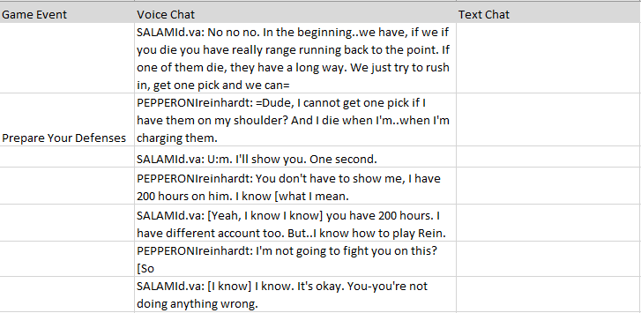
Findings: Productive Criticism

Slide 13
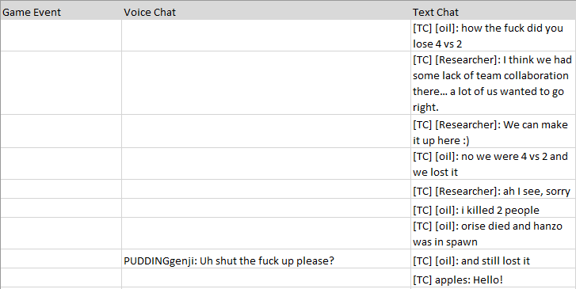
Findings: & Not-So Productive Criticism

Slide 14
Findings: Morale Boosts

Slide 15
So What Were We Trying to Answer Again?
What are the patterns of EAL learner social and linguistic interaction in a “hero shooter”?
Please see previous slides
How do the game mechanics and dynamics of “hero shooters” create affordances for language learners?
Time pressure and game mode
Skill rating incentivizes communication
Distinct classes and characters/responsibilities
There can only be one of each character per team at a time
Negotiation, negotiation, negotiation
Notes:
Negotiation: Comp, indiv character, and strategy

Slide 16
Where to go from here?
Different classes may equate to different communicative preferences
Or vice versa
Gender and class roles
Gamer identity and motivation
Opportunities for language that doesn’t occur in the classroom
Samantha wants to make a corpus of naturally-occurring game discourse across a variety of game genres
Sounds awesome, right? Find out more at samantha.games

Slide 17
Q&A and Contact Information
Samantha Kirby Lecturer and Gamer University of Arizona e: samkm@email.arizona.edu w: samantha.games
Michelle Vonie PhD Candidate University of Arizona e: vonie@email.arizona.edu

